Slide 1
Crawling for finance
류지승

Slide 2
가격

Slide 3
Robots.txt 이해하기
http://egloos.zum.com/engjjang/v/10106048
User-agent: * Disallow: /
모두 차단
User-agent: Cowbot Disallow: User-agent: Googlebot Disallow: User-agent: * Disallow: /
구글 네이버만 허용하고 다른 것은 차단

Slide 4
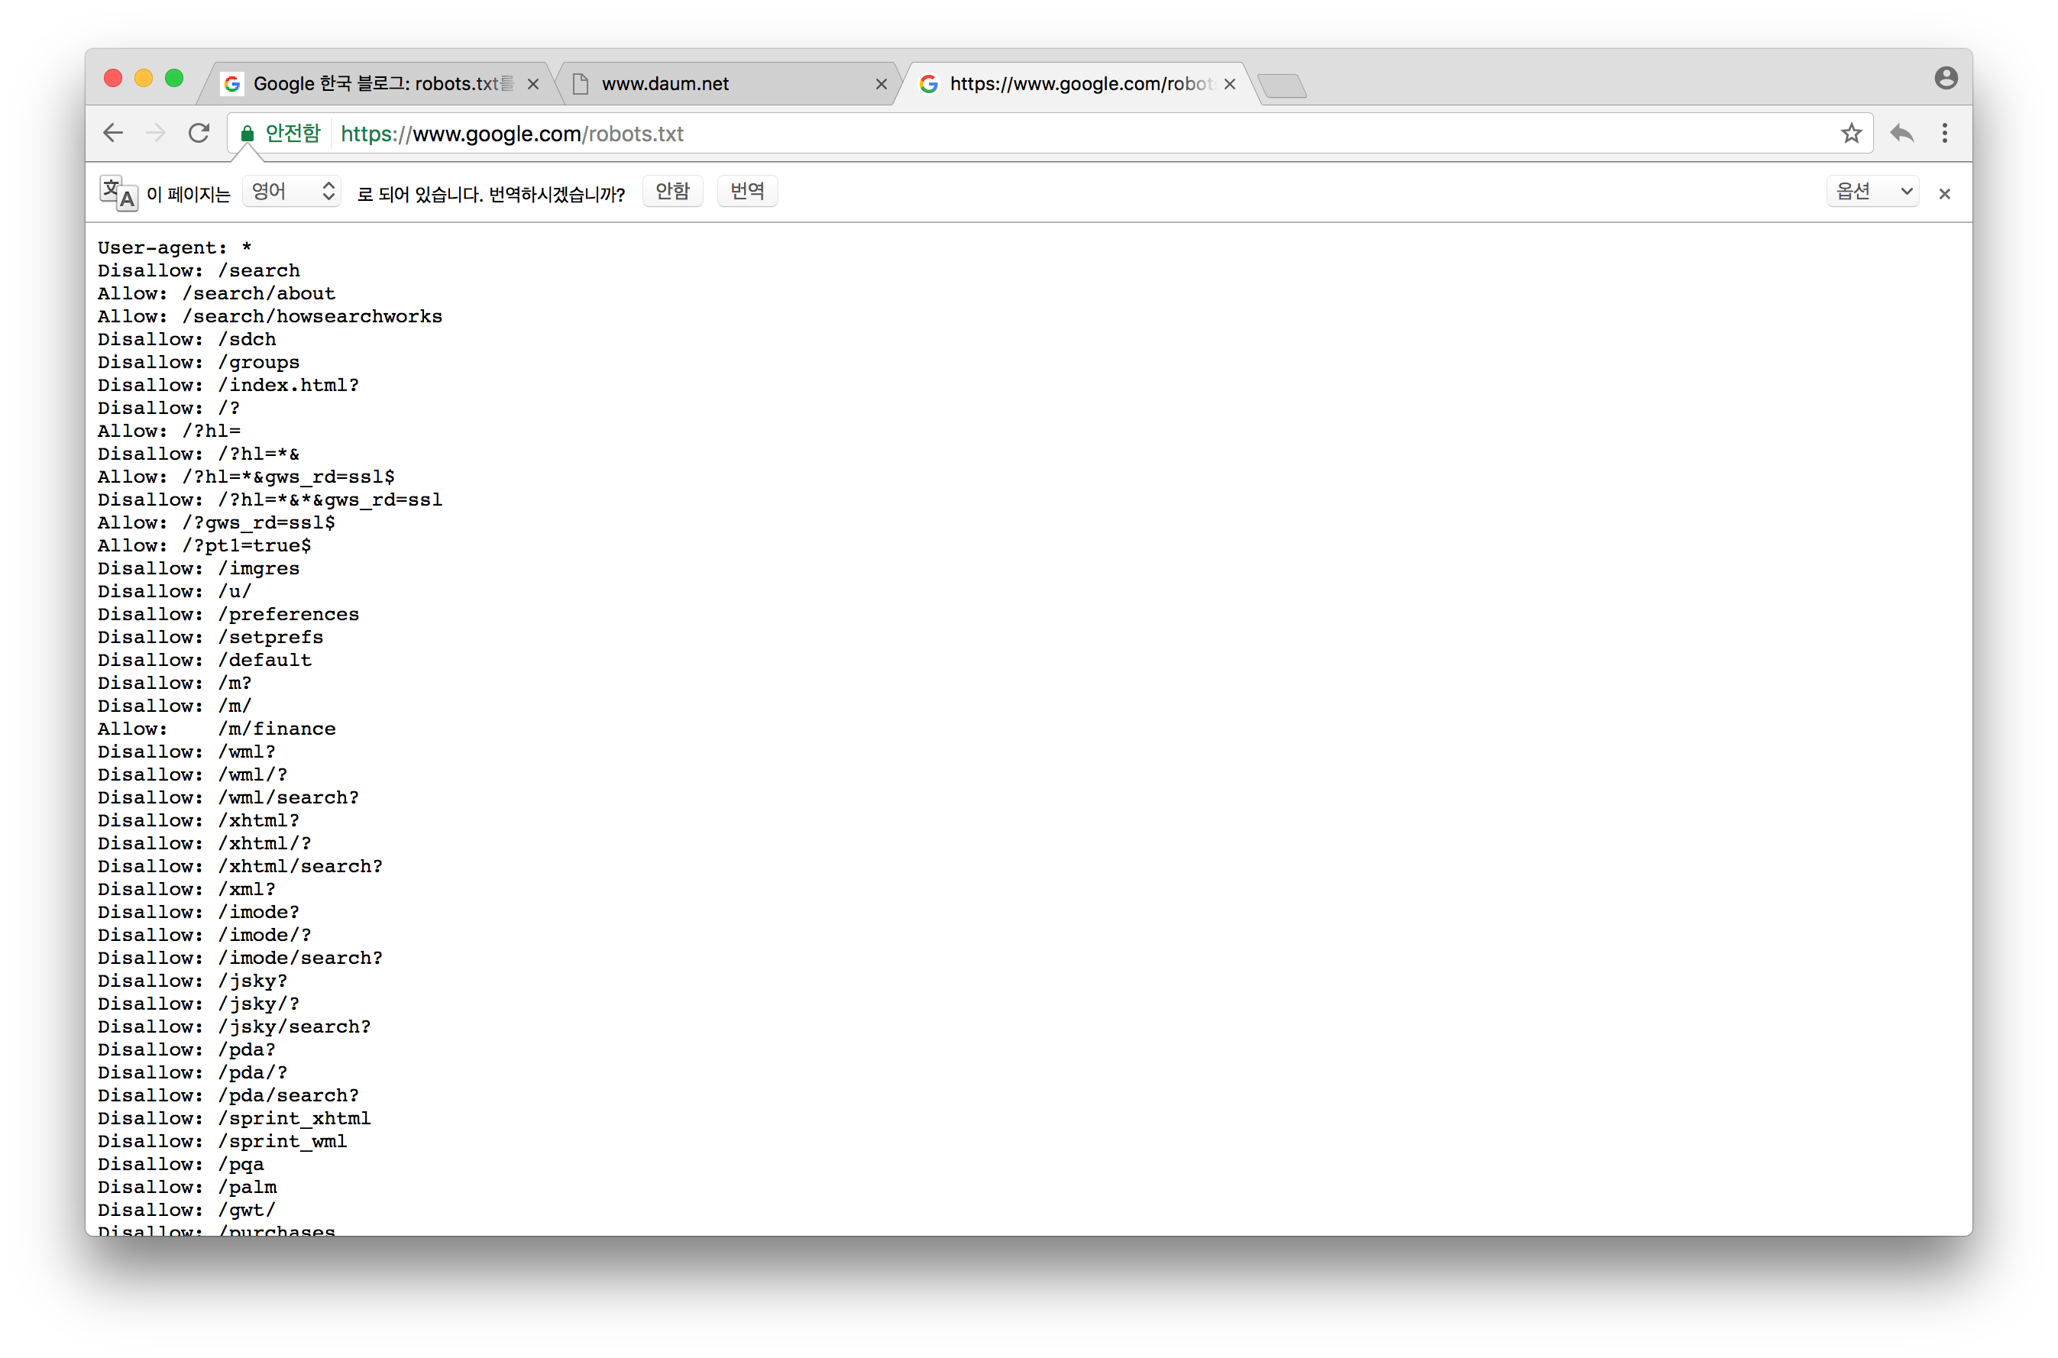
Google.com/robots.txt
https://www.google.com/robots.txt

Slide 5
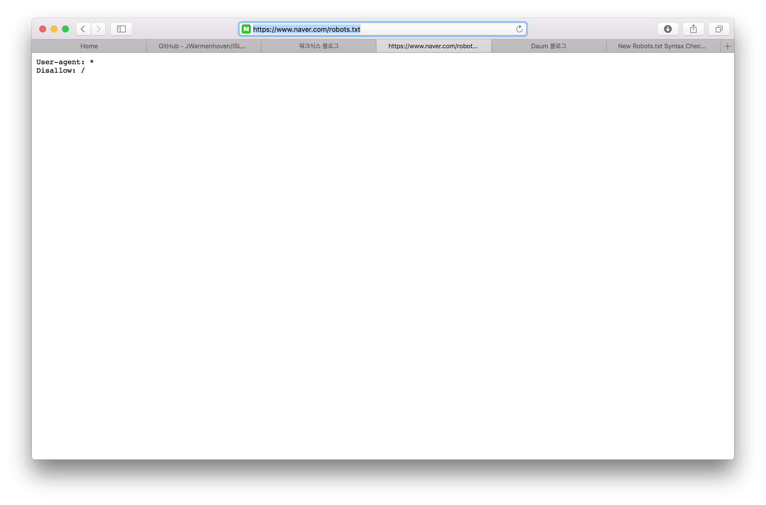
www.naver.com/robots.txt
https://www.naver.com/robots.txt

Slide 6
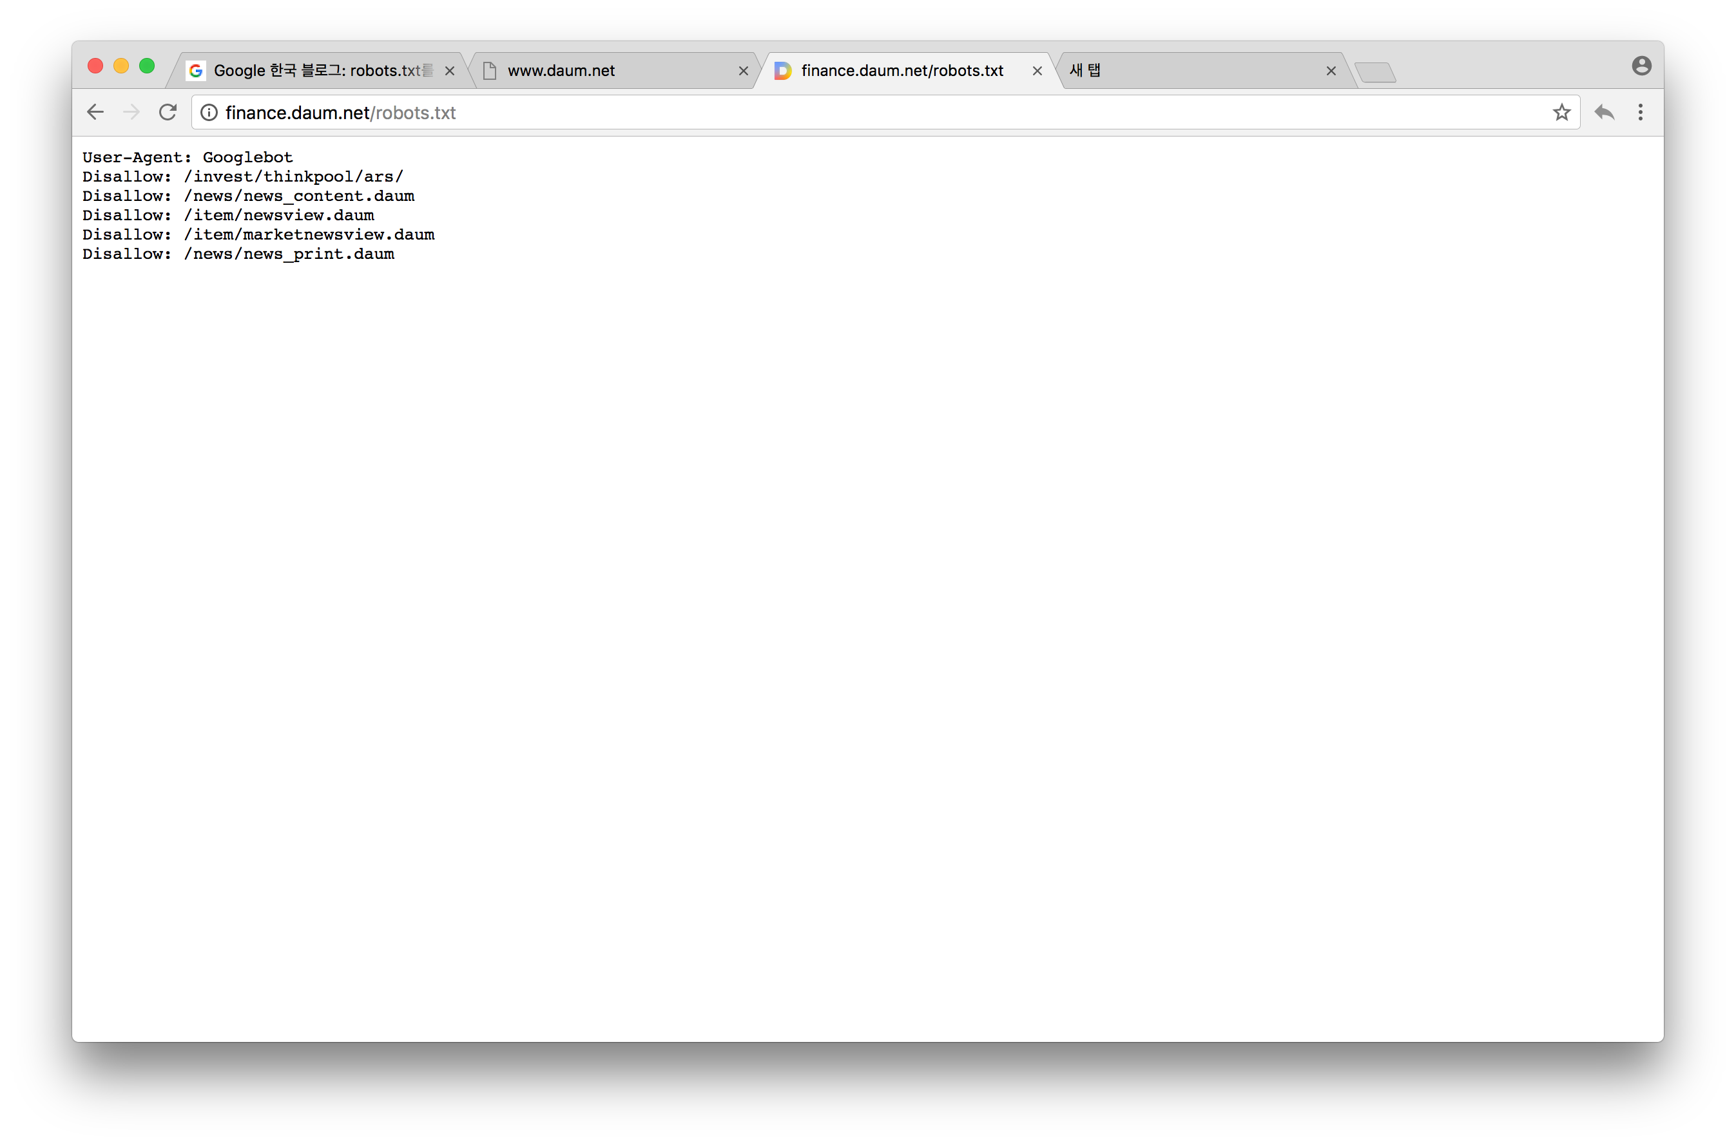
www.daum.net/robots.txt
http://finance.daum.net/robots.txt

Slide 7
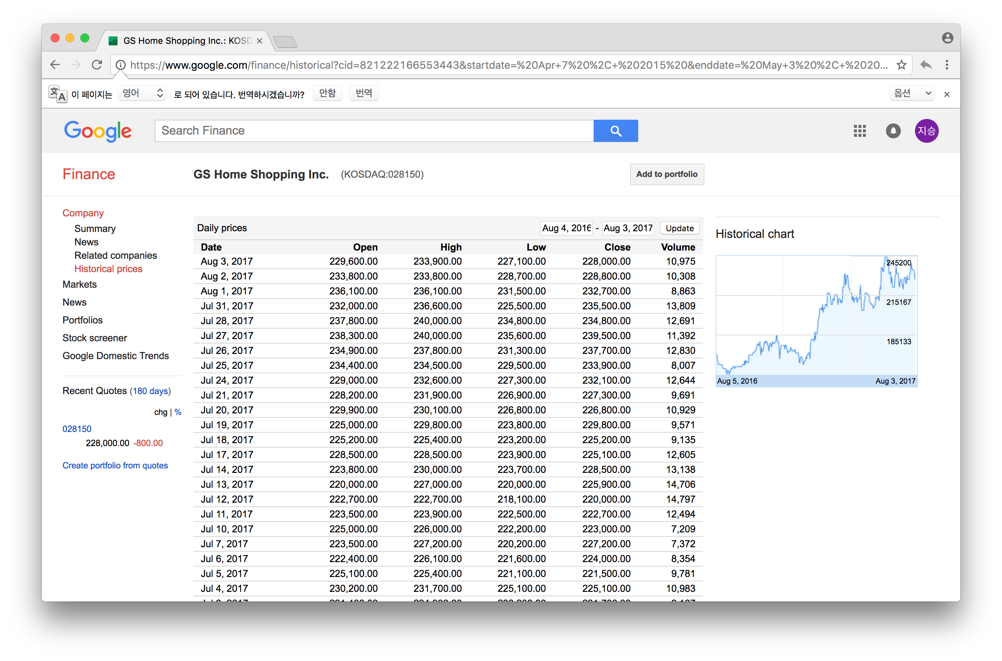
GS 홈쇼핑(Google finance)

Slide 8
Url 분석하기
https://www.google.com/finance/historical?cid=821222166553443&startdate= Apr+7 %2C+ 2015 &enddate= May+3 %2C+ 2017 &num= 200

Slide 9
사용자 편의에 맞게 Url 수정
library(stringr)
startdate<-"2015/04/29”
enddate<-"2016/03/02”
month<-c("Jan","Feb","Mar","Apr","May","Jun","Jul","Aug","Sep","Oct","Nov","Dec")
startyear<-as.numeric(str_sub(startdate,1,4))
startmonth<-month[as.numeric(str_sub(startdate,6,7))]
startday<-as.numeric(str_sub(startdate,9,10))
endyear<-as.numeric(str_sub(enddate,1,4))
endmonth<-month[as.numeric(str_sub(enddate,6,7))]
endday<-as.numeric(str_sub(enddate,9,10))
num<-200
url<-https://www.google.com/finance/historical?cid=821222166553443&startdate=
url1<-url%>%paste(.,startmonth,"+",startday,"%2C+",startyear,"&enddate=",endmonth,"+",endday,"%2C+",endyear,"&num=",num,sep="")

Slide 10
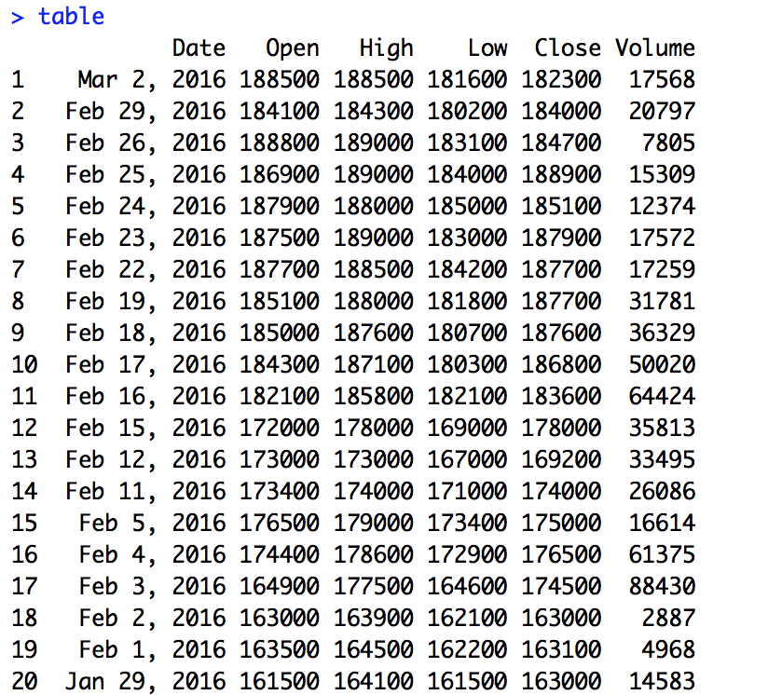
가격과 관련된 정보 가져오기 (Date,Open,High,Low,Close,Volume)
library(rvest)
table_url<-read_html(url1)%>%html_nodes("div#prices")%>%html_nodes(".gf-table.historical_price")
table<-html_table(table_url)[[1]]
for(i in 2:6) { table[,i]<-as.numeric(gsub(",","",table[,i]))}
table

Slide 11
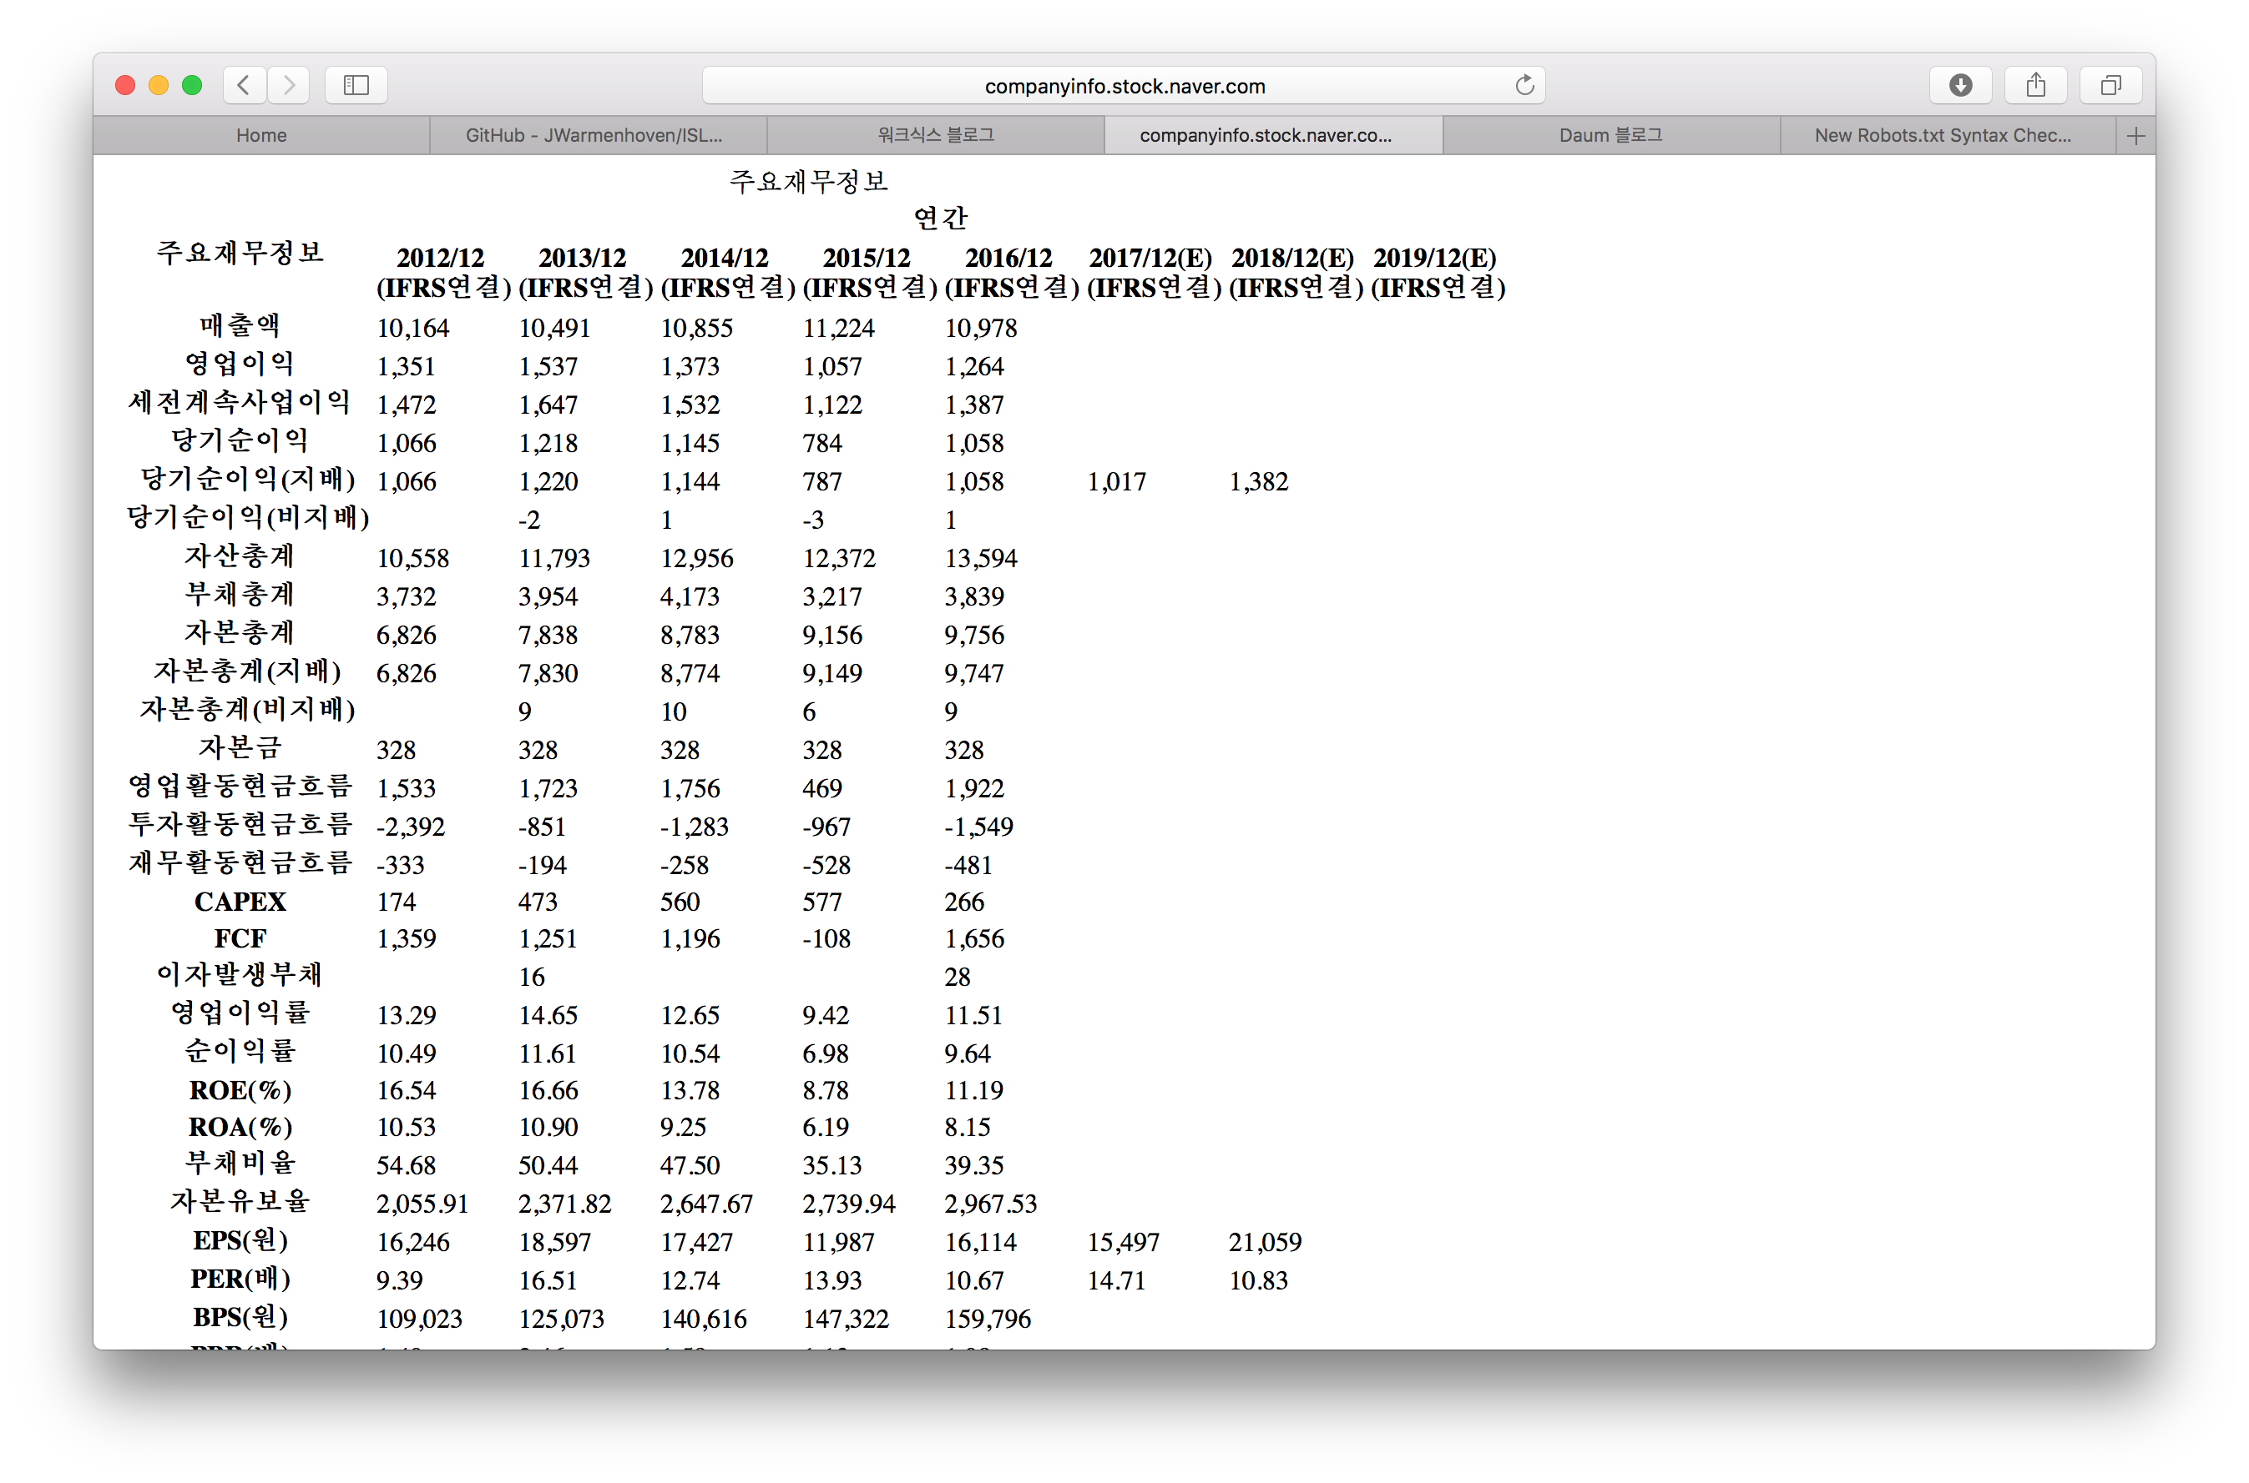
재무제표
http://companyinfo.stock.naver.com/v1/company/ajax/cF1001.aspx?cmp_cd=028150fin_typ=0&freq_typ=Y
oper<-http://companyinfo.stock.naver.com/v1/company/ajax/cF1001.aspx?cmp_cd=
code<-"028150”
oper1<-oper%>%paste(code,"fin_typ=0&freq_typ=Y",sep="")

Slide 12
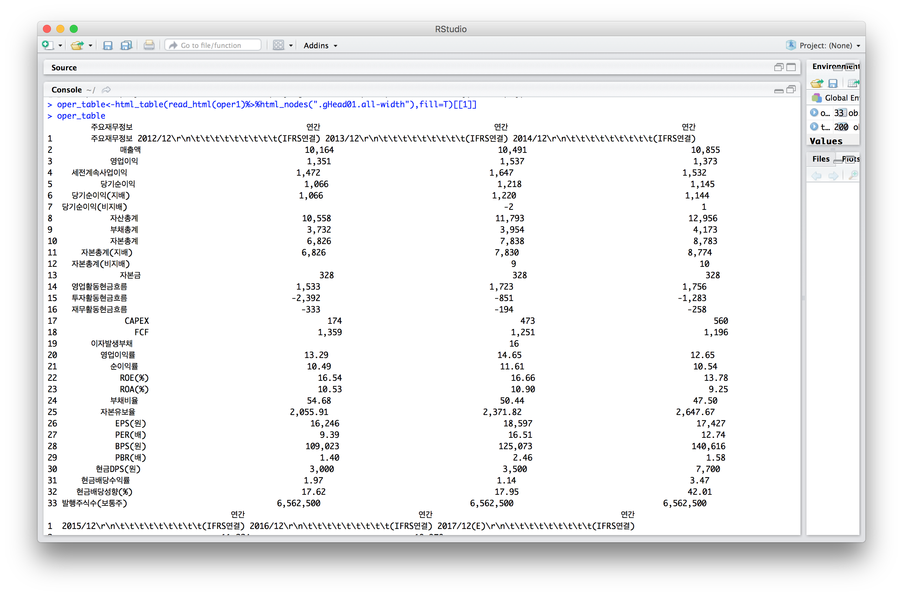

Slide 13
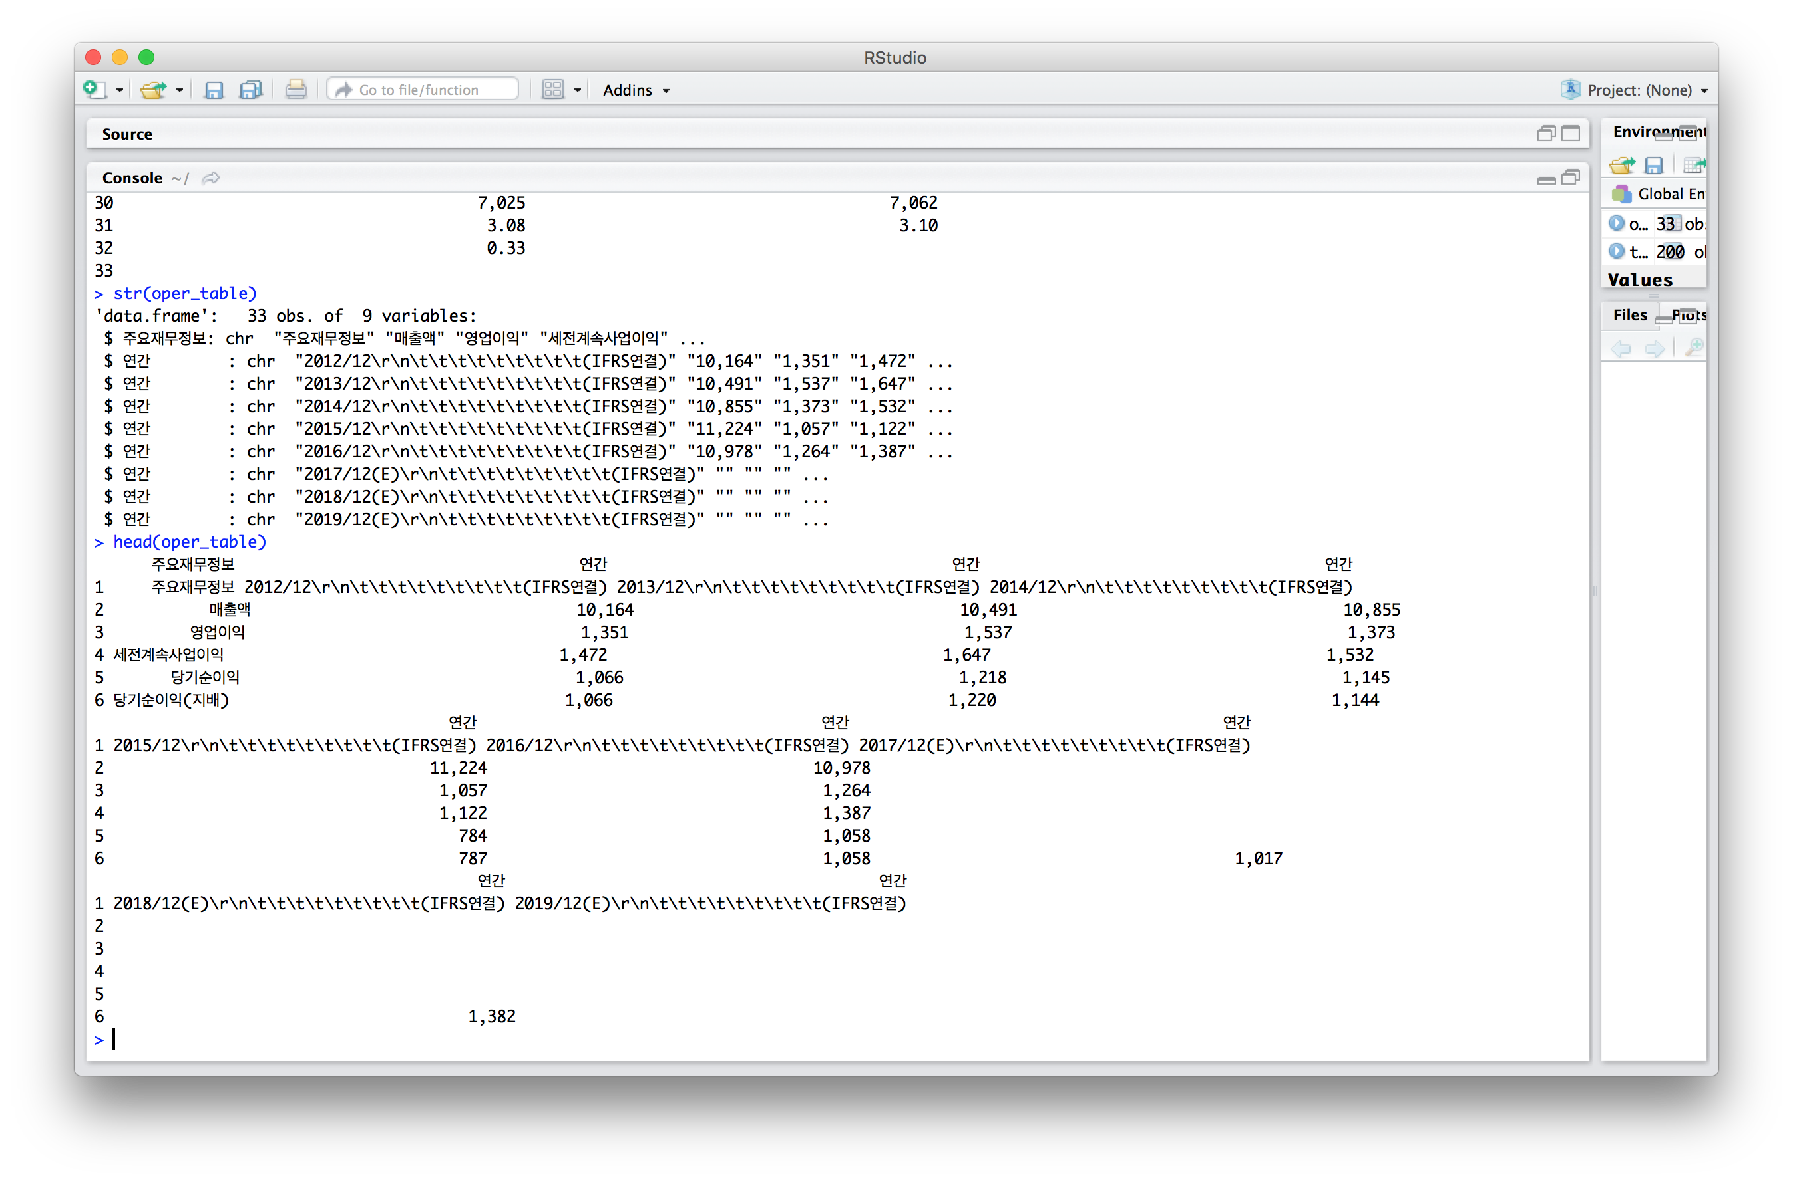

Slide 14
